Slide 1

Independent Project
Smart Wireless Water Meter

Slide 2
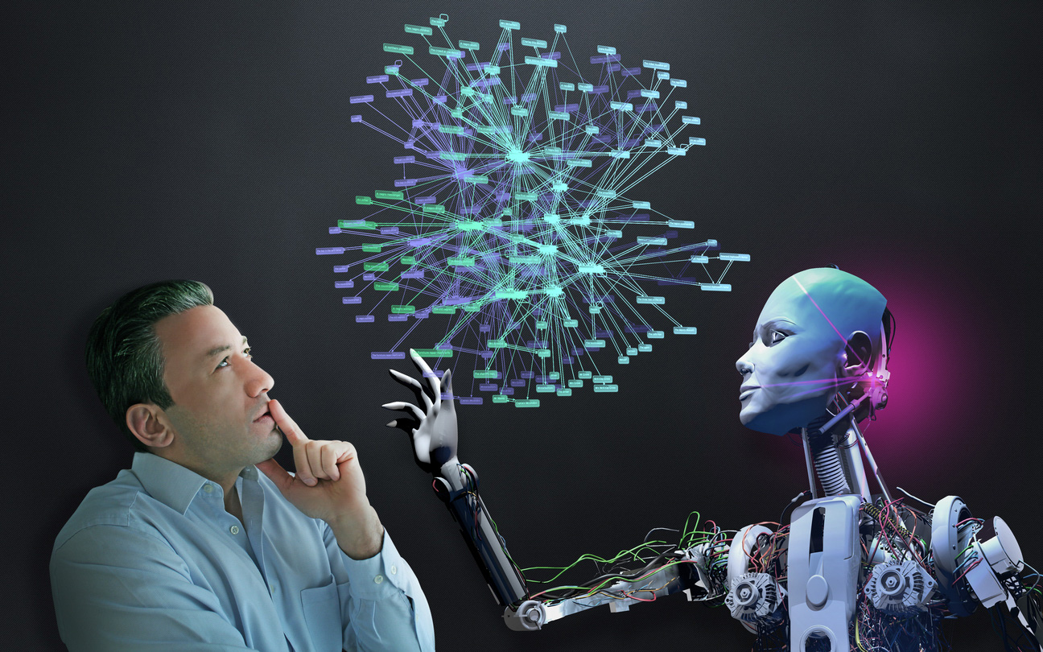
Team Members
NIDHI SHARMA (21BCS9922)
RAKESH SAINI (21BCS9964)
SAMEER (21BCS9975)
AASHI JAIN (21BCS9979)

Slide 3


Introduction
There is shortage of drinking water and unsustainable stress is being imposed on drinking water resources.
In recent years, demand for water has increased in households.
Consumer awareness about the day water consumption is very low.
Traditional water meters cannot be used on a daily basis and water consumption are calculated once a month.

Slide 4
Introduction
Our Smart Wireless Water Meter project enables apps to automatically collect usage data, remove manual meter readings, improve efficiency and saves costs. It also provides an opportunity to detect leaks and rare use more effectively than manual methods
The proposed system contains a Smart Water Meter (built with Arduino, breadboard, ultrasonic sensor, IC7239, DC motor and Peizo Alarm)

Slide 5
Key features
Monitor the flow, distribution and consumption of water.
Improve leak and fraud detection.
Increase data collection accuracy.
Enable real-time or frequent access to water consumption information and billing.
More economical for users.
Saved water can be supplied to areas suffering from water scarcity.

Slide 6
Objectives
Capable of implementing the volume based slab system. After reaching each limit the consumer are informed and cautioned through an alarm.
Develop an online platform to upload meter reading.
To estimate household water consumption and pattern by recording accurate readings.
To analyze water-saving potential for the residential sector.

Slide 7
Platform
We have used :
TinkerCAD

Slide 8
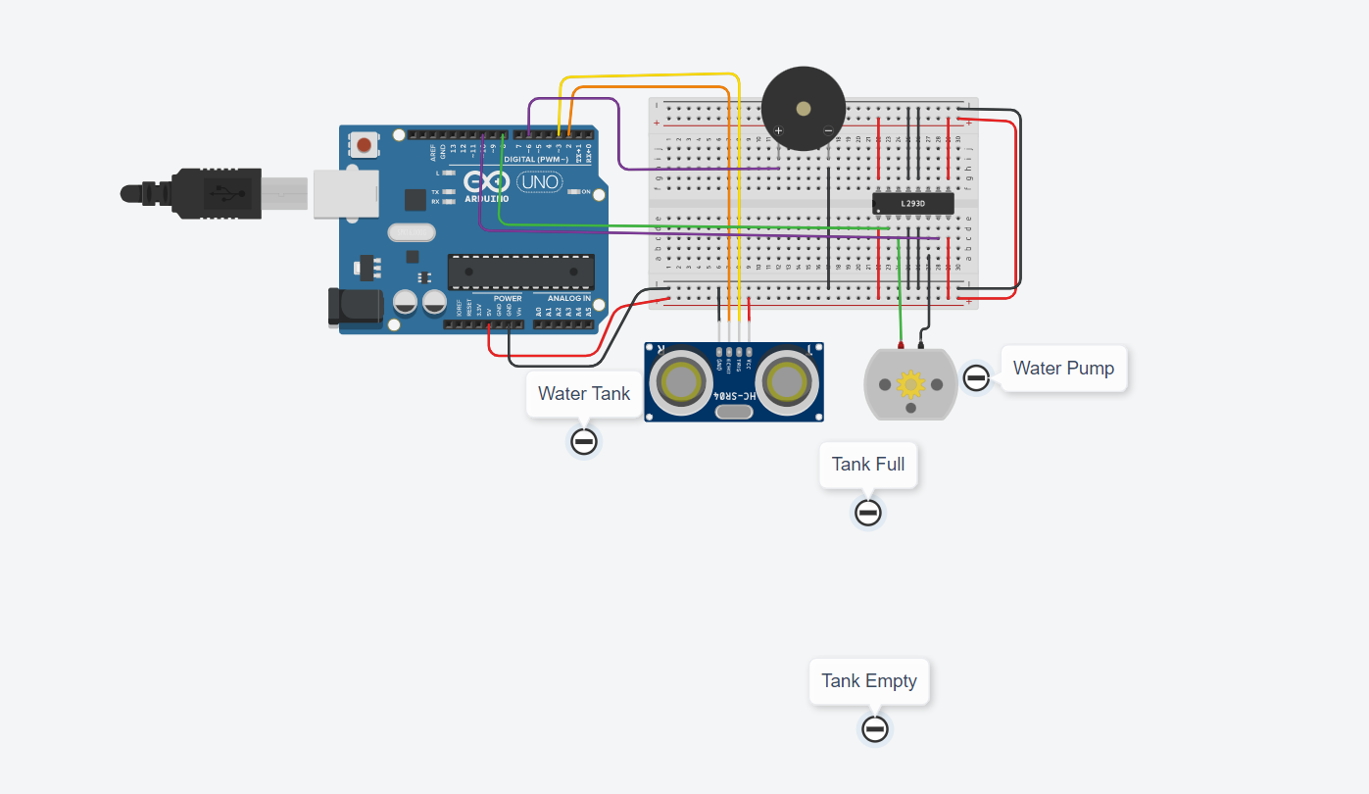
Project Overview

Slide 9
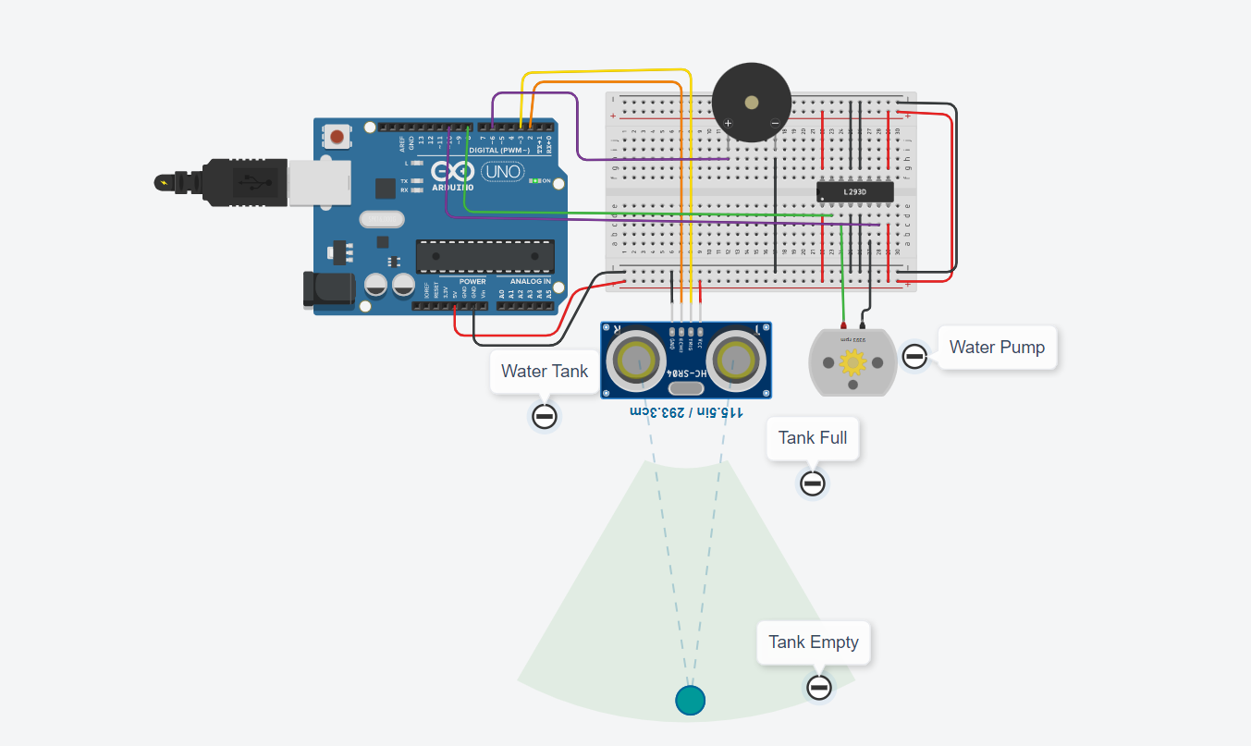
Project Overview

Slide 10

Project Overview

Slide 11
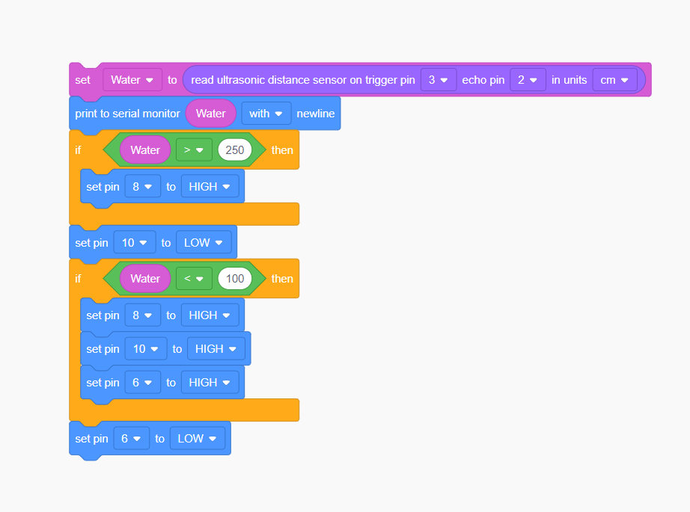
Code

Slide 12
Result
The outcome of this project is a simple Arduino-controlled smart water meter that measures the amount of water consumed by the residential sector. During the operation of water meter, water flows through the flow sensor which is a device that detects and measure flow through pipes. The water flow follows through the DC motor.
Link:
https://www.tinkercad.com/things/5pe6OqkFua9-water-level-indicator/editel

Slide 13
Conclusion and Future Scope
A smart water meter can solve many of the problems facing existing meters. Although the maximum efficiency of the proposed meter has not been achieved, there is scope for future upgrades and further improvements.
Instead of installing one meter in each house, provisions can be made to allow for different monitoring of water use in each section such as kitchen, bathroom etc. It can then monitor and control the water used.
All additional infrastructure created can be automated with high accuracy. By knowing the correct use of water in different parts of the same house, you may know that there is a leak.
Leaks or theft if any can be repaired individually, which can be easily repaired.

Slide 14
Reference and Gratitude
T Randall, Richard Koech, ‘Smart Water Metering Technology for Water Management in Urban Areas Analyzing water consumption patterns to optimise water conservation’,
DOI:10.21139/wej.2019.001
Sarala S.M, ‘Smart Water Meter Using Wireless Networking’,
Project Reference No: 40S_BE_0108, 2019
We would like to thank to our Independent Project Teacher (Mr. Rojit Bajaj) for guiding and helping us in the execution of project.

Slide 15
THANK YOU

